Slide 1



IVY PROFESSIONAL SCHOOL
AMAZON SALES 2025 ANALYSIS
BY Swetanshu Chakladar

Slide 2
Slide 1: Introduction – Business Problem
IVY PROFESSIONAL SCHOOL
Forecasting Need: Amazon needs to estimate next month’s sales to plan inventory, marketing, and logistics efficiently.
Trend Identification: Analyzing monthly sales trends helps reveal seasonality and peak periods that impact planning.
Category Optimization: Knowing which product categories perform best allows Amazon to focus on high-revenue segments.
Customer Behavior Insight: Exploring the link between reviews and sales reveals how customer feedback influences purchase decisions.
Market Targeting: Understanding regional sales distribution helps prioritize high-performing areas and identify underperforming markets.

Slide 3
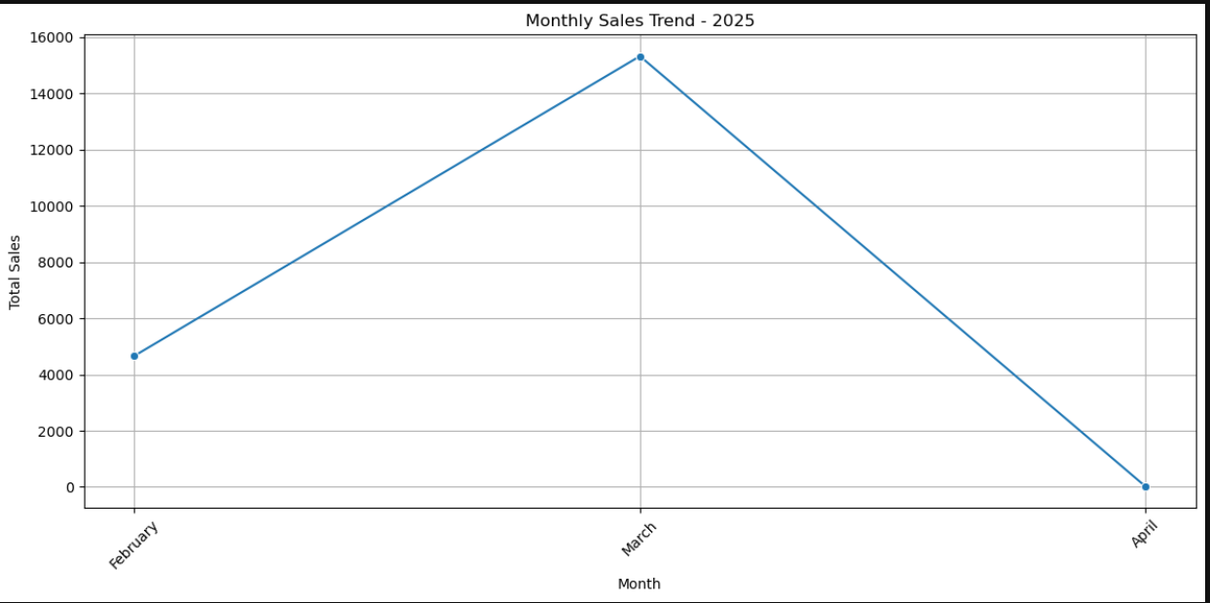
Slide 2: Monthly Sales Trend
IVY PROFESSIONAL SCHOOL
Seasonality Detection: Analyzing monthly sales helps identify seasonal peaks and dips in customer purchasing behavior.
Strategic Planning: Recognizing high and low sales months supports better inventory and staffing decisions.
Marketing Alignment: Helps align promotional campaigns with months showing historically high customer engagement.
Sales Forecasting: Monthly trends provide a baseline for predicting future sales with improved accuracy.
Business Agility: Enables Amazon to proactively respond to predictable demand changes rather than reactively adjusting.

Slide 4
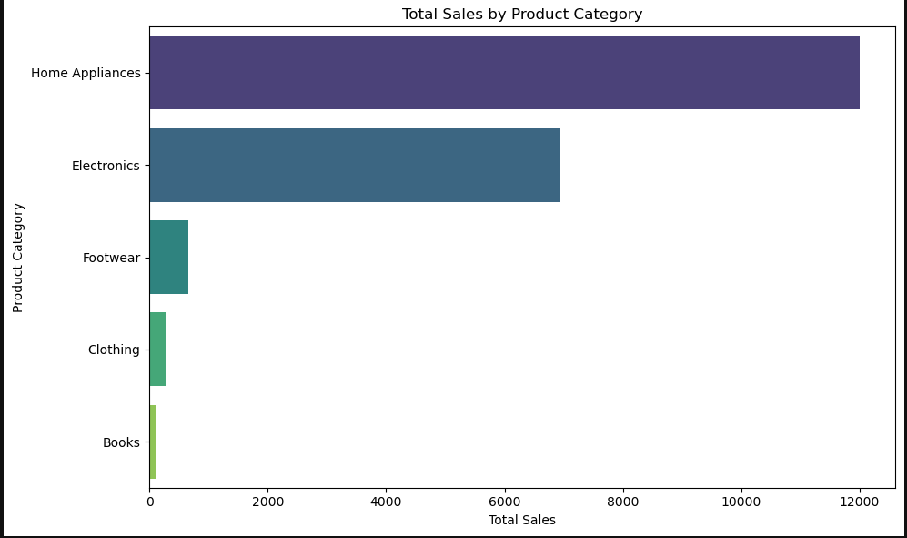
Slide 3: Top-Selling Product Categories
IVY PROFESSIONAL SCHOOL
Revenue Drivers: Identifying top-performing categories reveals which products contribute most to total sales.
Product Focus: Helps Amazon prioritize investment, inventory, and marketing in the most profitable categories.
Customer Preferences: Reflects consumer demand trends, guiding future product development or partnerships.
Resource Allocation: Supports strategic allocation of resources (ads, discounts, warehouse space) to high-impact areas.
Sales Strategy Refinement: Enables data-driven decisions for bundling, cross-selling, or promotions within key categories.

Slide 5
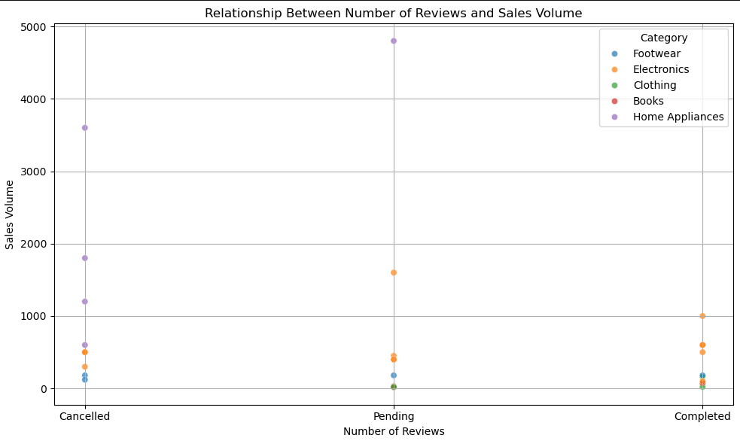
Slide 4: Relationship Between Reviews and Sales Volume
IVY PROFESSIONAL SCHOOL
Social Proof Impact: Reviews serve as trust signals—more reviews can boost buyer confidence and influence purchase decisions.
Sales Correlation: Analyzing the scatter plot reveals whether higher review counts are associated with greater sales volumes.
Customer Engagement Indicator: A high number of reviews may reflect strong customer interaction and product popularity.
Marketing Insight: Products with few reviews but good sales might benefit from review solicitation campaigns to enhance credibility.
Conversion Optimization: Understanding this relationship can help Amazon refine product page strategies to drive higher conversions.

Slide 6
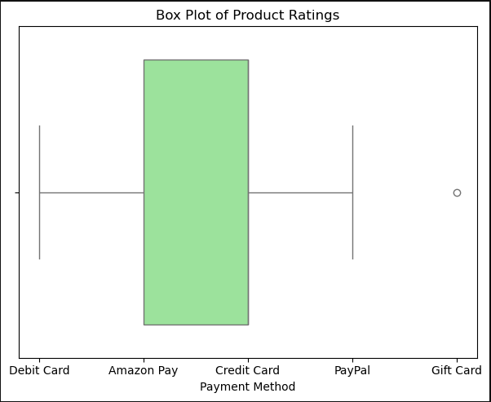
Slide 5: Distribution of Product Ratings Across All Products
IVY PROFESSIONAL SCHOOL
Quality Assessment: Analyzing rating distribution helps gauge overall product quality from the customer's perspective.
Customer Satisfaction Insight: High average ratings suggest satisfied customers, while low ratings may indicate quality or service issues.
Outlier Detection: Box plots or histograms highlight unusually low or high-rated products that may need attention or promotion.
Reputation Management: Understanding rating trends allows Amazon to proactively address negative feedback and maintain brand trust.
Improvement Opportunities: Identifies categories or products with lower ratings that could benefit from quality enhancement or better customer support.

Slide 7
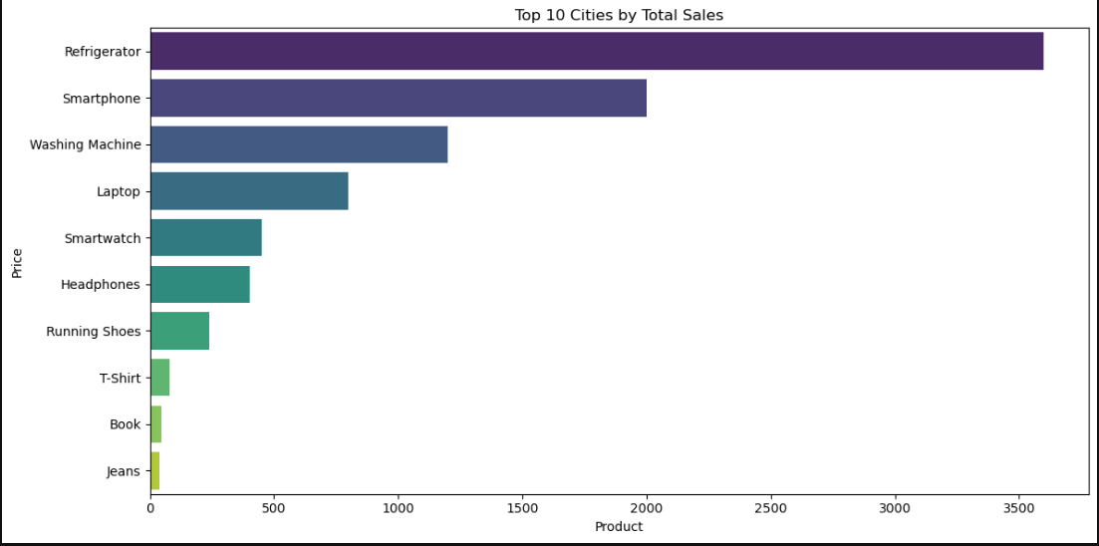
Regional Contribution to Total Sales
IVY PROFESSIONAL SCHOOL
Market Performance Analysis: Identifies which regions, states, or cities generate the highest sales volumes.
Geographic Targeting: Helps Amazon tailor regional marketing and promotional efforts for maximum impact.
Logistics Optimization: High-performing areas may require enhanced supply chain and delivery infrastructure.
Growth Opportunity Spotting: Reveals underperforming regions that could benefit from targeted sales strategies.
Customer Demographics Insight: Geographic trends can reflect customer preferences and spending behavior by location.

Slide 8
Conclusion
IVY PROFESSIONAL SCHOOL
Monthly Sales Trends Identified: Clear seasonality patterns were found, enabling more accurate forecasting of next month’s expected sales.
Top Sales Drivers Revealed: Product categories with the highest revenue were pinpointed, helping prioritize inventory and marketing strategies.
Customer Review Impact Confirmed: A positive correlation between number of reviews and sales volume shows reviews are a key sales influencer.
Product Quality Assessed: Rating distributions provided insight into customer satisfaction, which can affect repeat purchases and brand trust.
Geographic Sales Patterns Uncovered: High-performing regions were identified, allowing for region-specific strategies to boost sales.

Slide 9
THANK YOU

